Slide 1
Workshop 3: joint design & beam balancer deliverables
Paul Groh, MME Department

Slide 2
OVERVIEW
Joint Design:
Sleeve bearings
Roller Bearings
Examples of mounted bearings
Beam Balancer Design Problem:
Deliverables
Manufacturing locations

Slide 3
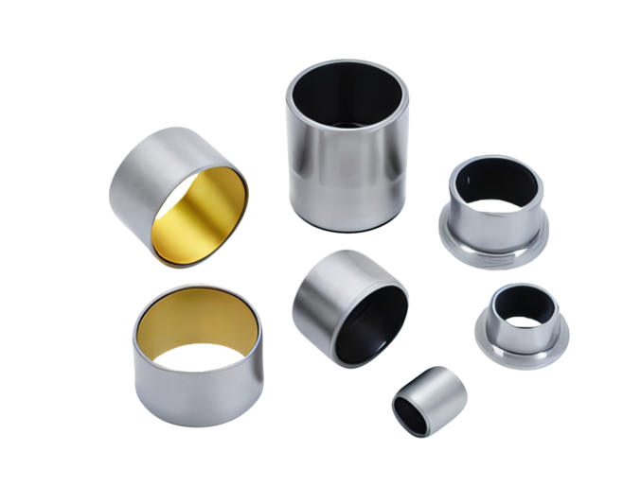
SLEEVE BEARINGS
A Cylindrical sleeve
Sometimes referred to as a ‘bushing’
No rolling elements
Made of metal, plastic, or composite material (oil-impregnated bronze, graphite-filled PEEK, etc)
Often lubricated to reduce wear and friction
Cheap to manufacture
Suitable for low to moderate loads (~145 psi) and speed (~150 ft/min)

Slide 4
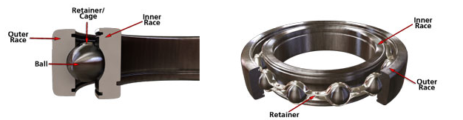
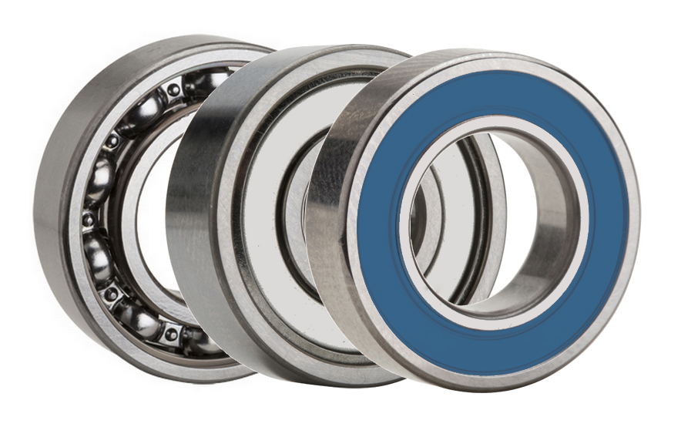
BALL BEARINGS
Rolling-element bearing
Inner and Outer Race
Shielded or un-shielded
Made of metal, but sometimes plastic
Ideal for low to moderate loads (~145 psi) and high-speed (~500 ft/min)

Slide 5
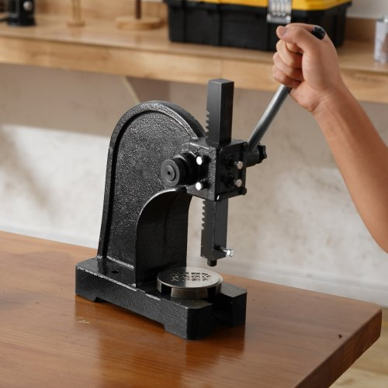
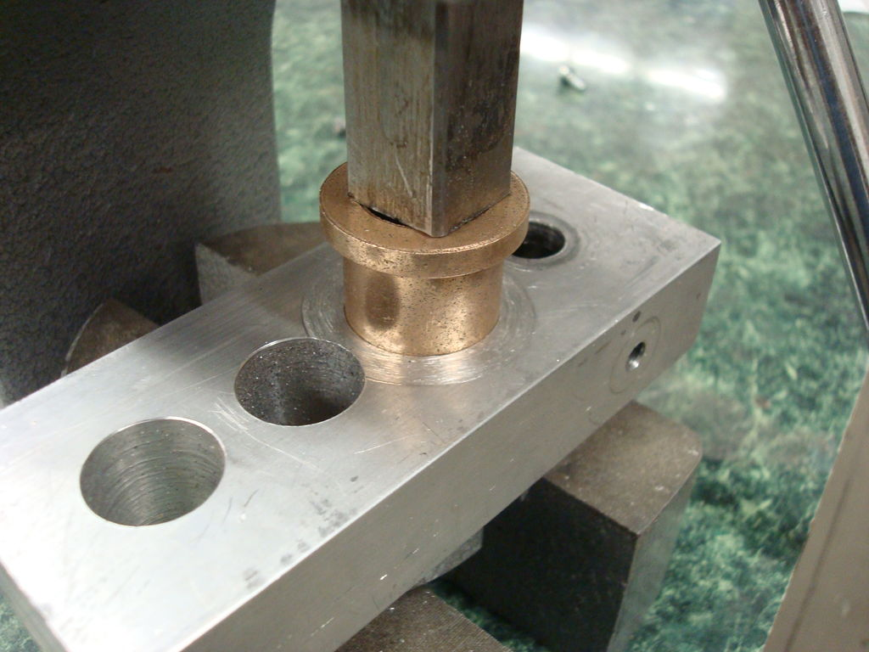
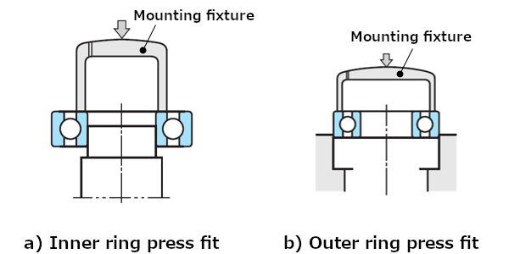
BEARINGS – HOW TO INSTALL INTO HOUSING
Several methods:
Method 1: Press Fit using a hydraulic or Arbor press
Interference fit: bearing’s outer diameter is slightly larger than the bore
Good for metal or resin printed parts
Method 2: Freeze the bearing before insertion
Method 3: Use a bonding agent
Slip fit: Machine housing bore to recommended inside diameter for a slip fit
Good for wood or PLA printed parts
Arbor Press
Arbor Press – Installing Sleeve Bearing

Slide 6
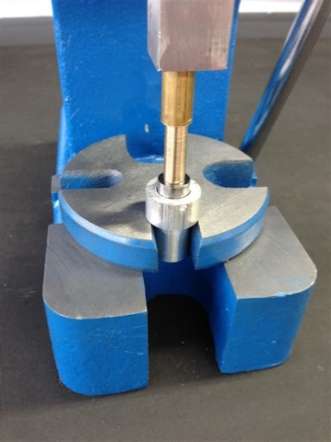
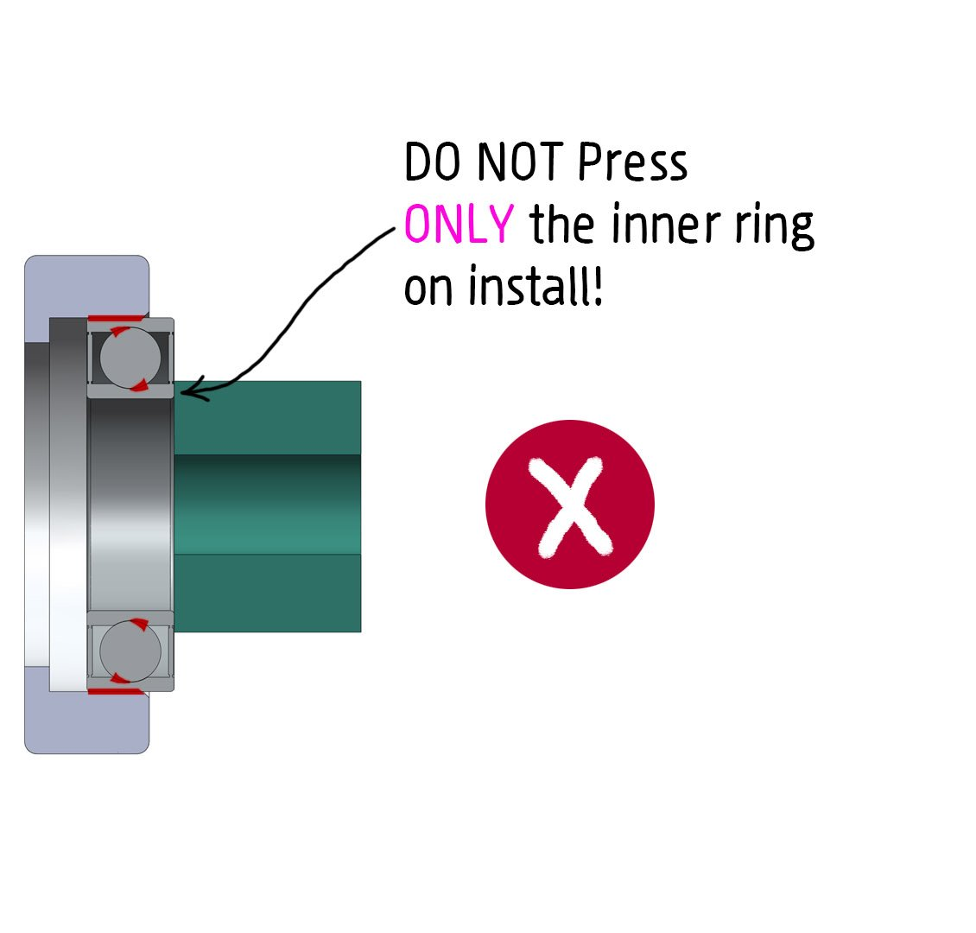
BEARINGS – HOW NOT TO INSTALL

Slide 7
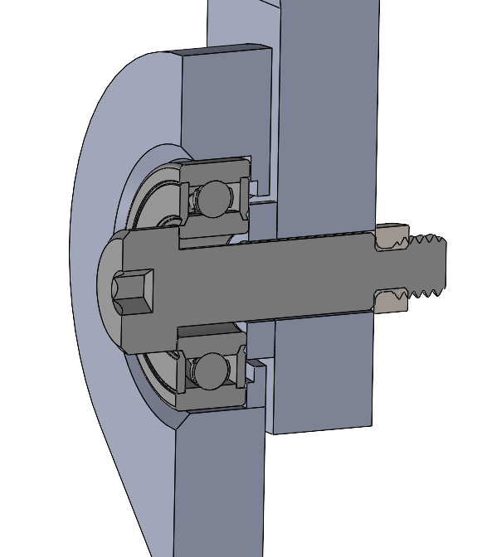
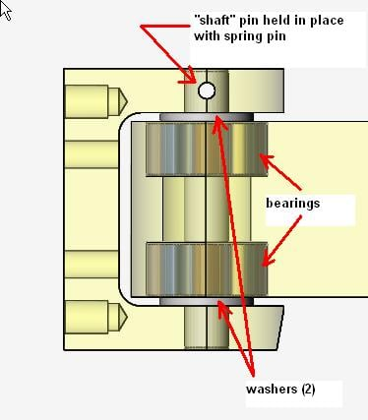
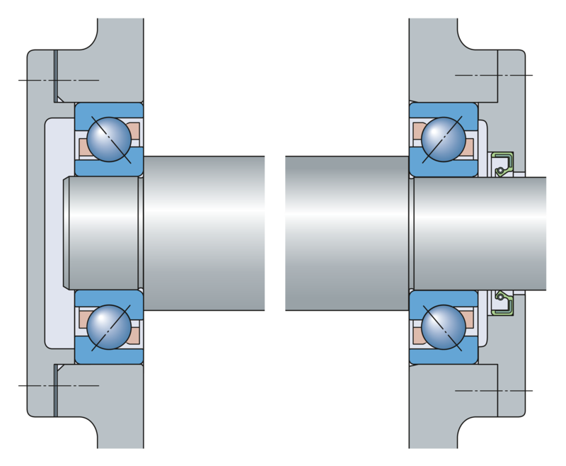
EXAMPLES OF BEARINGS IN JOINTS
EXAMPLE.1
EXAMPLE.2
EXAMPLE.3
Pivot Arm Design
Mounting a shaft with 2 Ball Bearings
Revolute joint with shoulder screw
NOTE: All of these examples can be modified for sleeve bearings

Slide 8
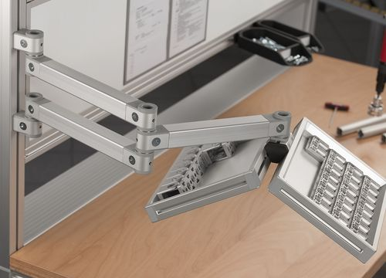
EXAMPLES OF BEARINGS IN JOINTS
EXAMPLE.1
Pivot Arm Design
NOTE: All of these examples can be modified for sleeve bearings

Slide 9
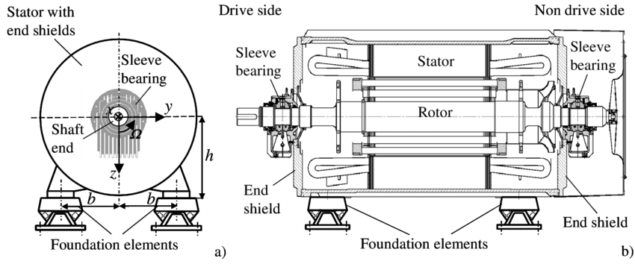
EXAMPLES OF BEARINGS IN JOINTS
EXAMPLE.2
Mounting a shaft with 2 Bearings

Slide 10
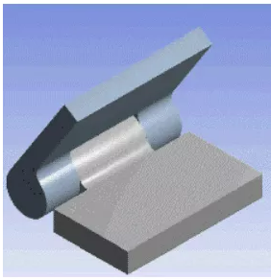
EXAMPLES OF BEARINGS IN JOINTS
EXAMPLE.3
Revolute joint with shoulder screw
NOTE: All of these examples can be modified for sleeve bearings

Slide 11
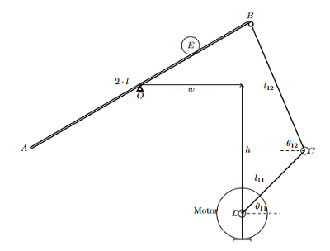
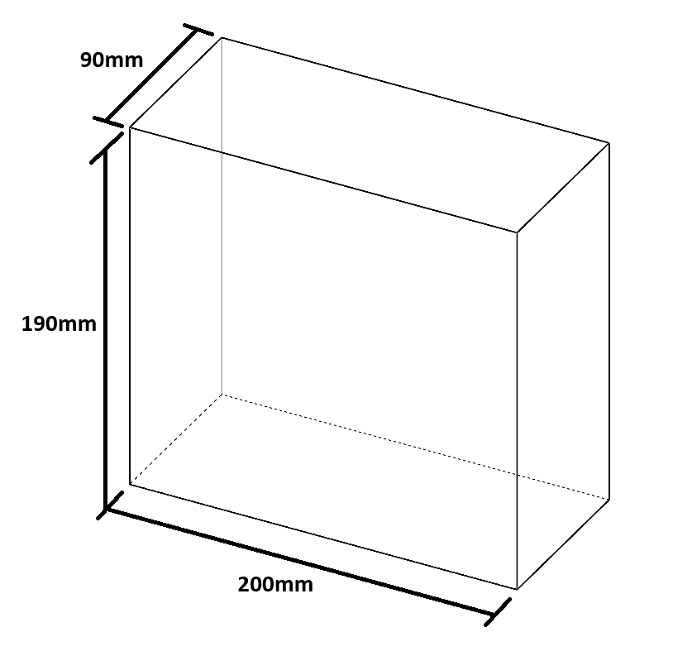
INTRO TO BEAM BALANCER DESIGN PROBLEM
Crank mechanism with 2 linkages
Using Kinematics Model derived in class to drive the servo motor to the desired position
Space constraint
Using MG995 servo motor
3 weeks to design, build, and demonstrate
Code to run the system will be provided
Uses a Web Cam and Arduino board to drive the Servo

Slide 12

DELIVERABLES FOR WEEK 4 (SEPT 24)
3D Model of your design (e.g. SolidWorks)
4 minute presentation in E3-3178 during the Workshop time slots (Wed, Sept 24 9:30AM – 11:30AM)
Show linkages and joints designs
Describe manufacturing methods
2 minute feedback from Staff
How to improve design
Suggestions on how to manufacture

Slide 13

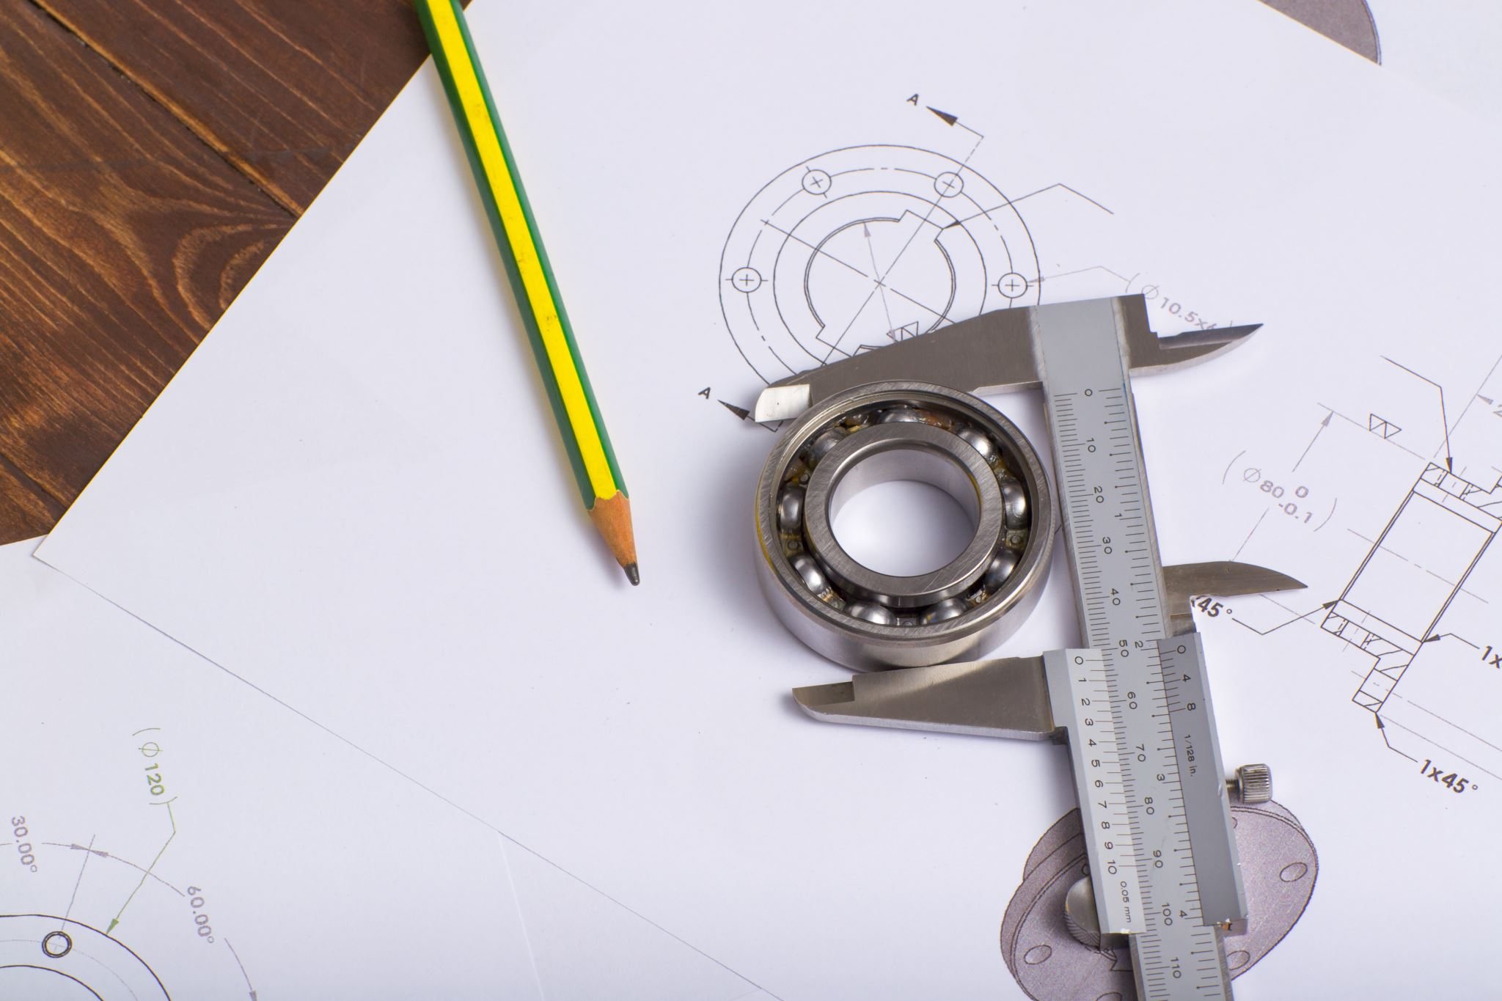
DELIVERABLES FOR WEEK 5 (OCT 1)
Beam balancer assembled with Servo Motor
4 minute presentation in E3-3178 during the Workshop time slots (Wed, Oct 1 9:30AM – 11:30AM)
Show progress so far
Outline plan to demonstrate functioning system next week

Slide 14

DELIVERABLES FOR WEEK 6 (OCT 8)
Beam Balancer Demonstration Requirements
Presentation Details:
Date & Time: Wednesday, Oct 8, 9:30AM – 11:30AM
Location: E3-3178
Format: 4-minute live demo during Workshop time slots
System Requirements:
Must balance a ball at the center of the beam.
Must return the ball to center after it is manually displaced a short distance.

Slide 15
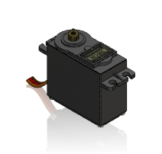
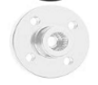
RESOURCES PROVIDED TO YOU
MG995 Servo with Metal Horn
STEP File available on LEARN
M3 x 10mm SHCS, QTY 6
Web cam, Arduino, Code, Raspberry Pi 5

Slide 16
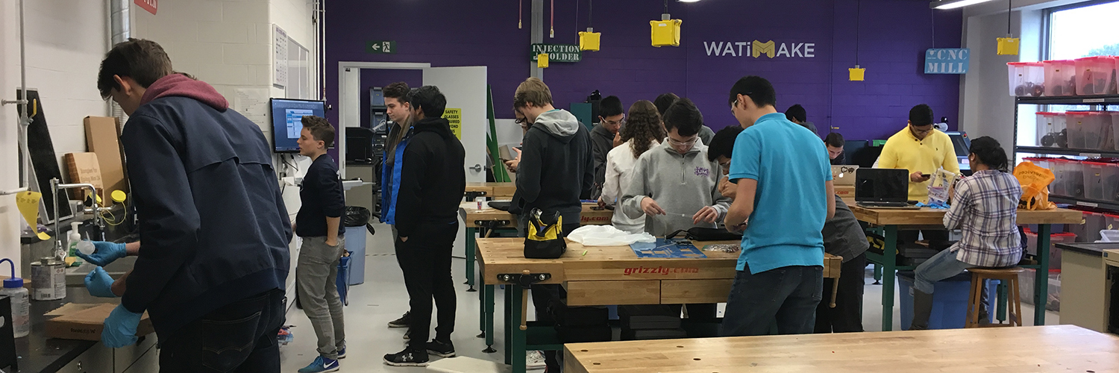
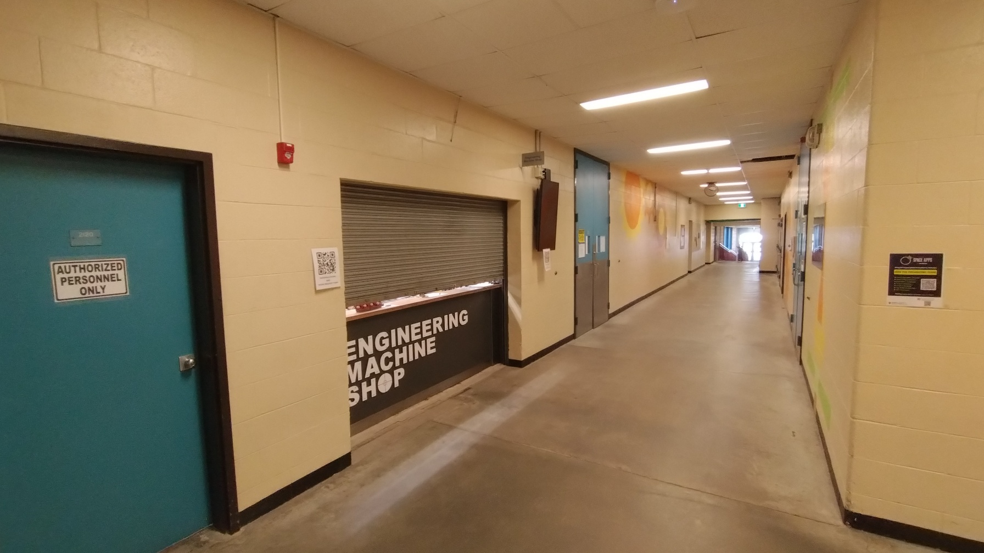
PLACES TO GET STUFF MADE
Locations on campus to get stuff made:
WATIMAKE, DWE 3509
WATiMake | Mechanical and Mechatronics Engineering | University of Waterloo
Engineering Machine Shop, E3
EMS Material Store
Mention the Course and your Group # to access your team funds*
* For hardware only

Slide 17
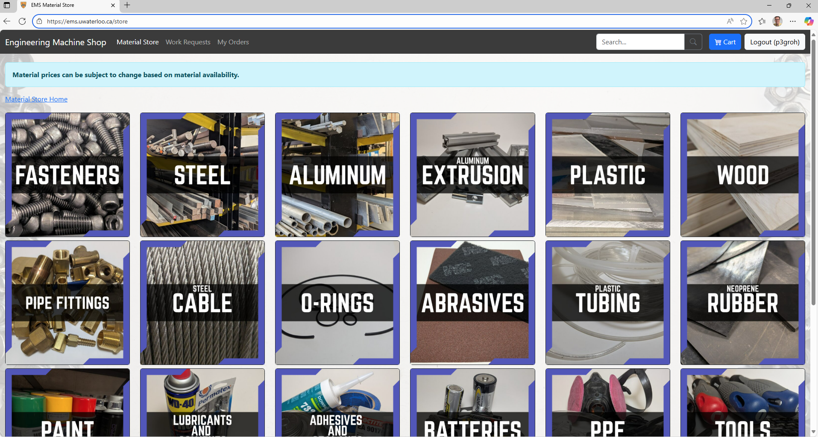
PLACES TO GET STUFF MADE – ORDERING FROM EMS
Visit the website to order:
EMS Material Store
Place order AHEAD of visiting EMS!
Saves time waiting in the hall for your order to be processed!
They email you when it is ready for pick up

Slide 18
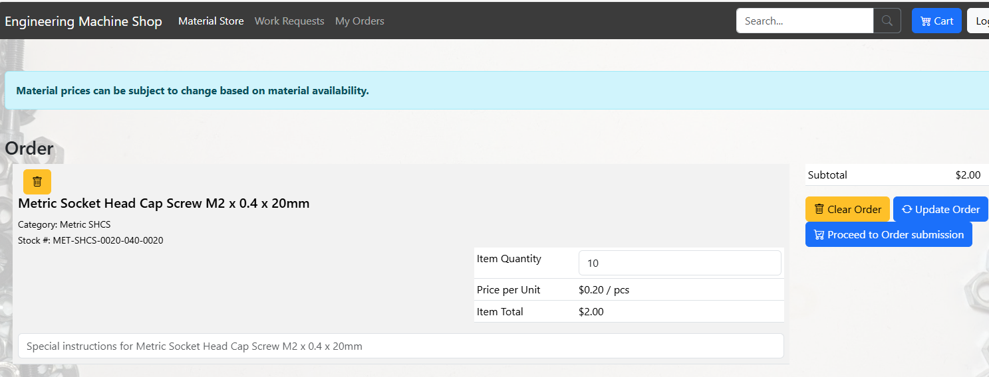
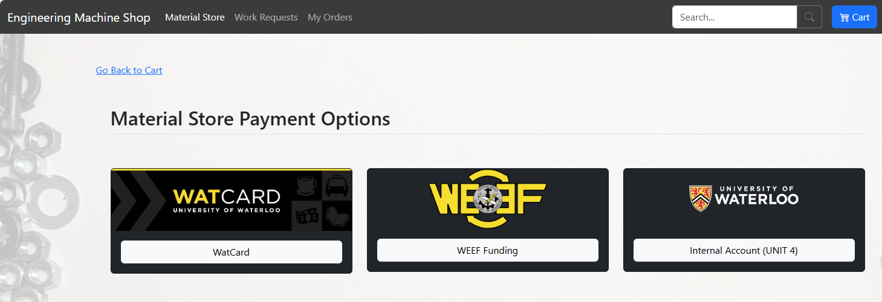
PLACES TO GET STUFF MADE – ORDERING FROM EMS
When you are ready to order:
Press “Proceed to Order Submission”
Select “WatCard” as Material Store Payment Option

Slide 19
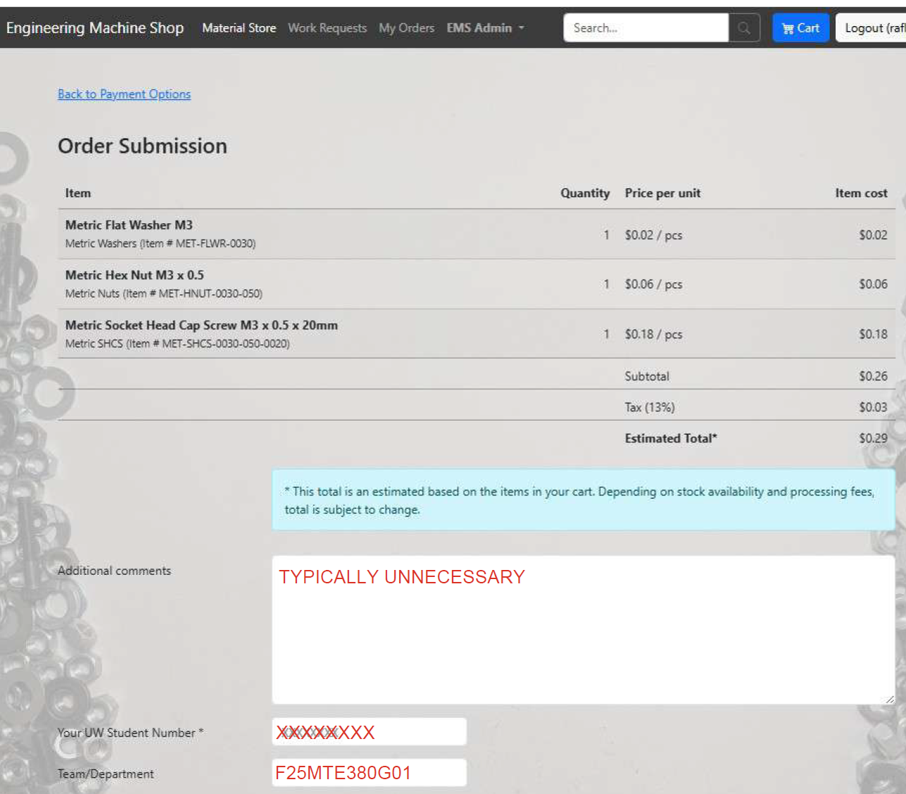
PLACES TO GET STUFF MADE – ORDERING FROM EMS
3. Enter your Student Number
4. Under Team/Department, type in EXACTLY “F25MTE380G__ ”
NO reimbursement for WATCARD purchases

Slide 20
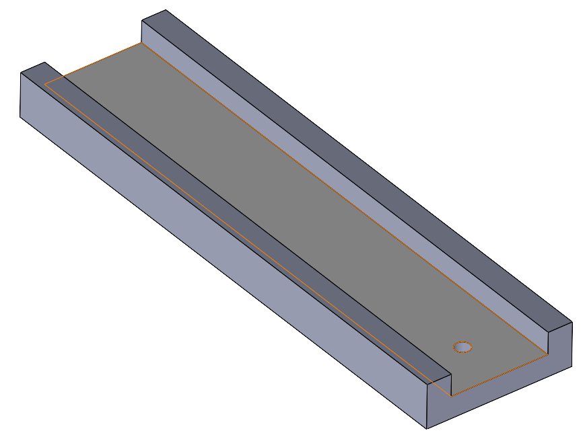
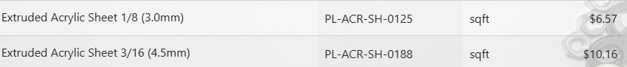
DESIGN TIPS / MAX SPENDING LIMIT
Beam can have edges to prevent ball from falling off
Only 3D print parts that cannot be laser cut (laser cutting is faster!)
4.5 mm thick acrylic is adequate for structural parts
3 mm thick acrylic for balancing beam
Keep extra acrylic for later in the term!
Max Spending Limit, $50 per team
WATIMAKE Price List For Clear Acrylic
Size | Thickness | Cost
12” x 24” | 3.0 mm | $13
12” x 24” | 4.5 mm | $20
EMS Price List For Clear Acrylic

Slide 21
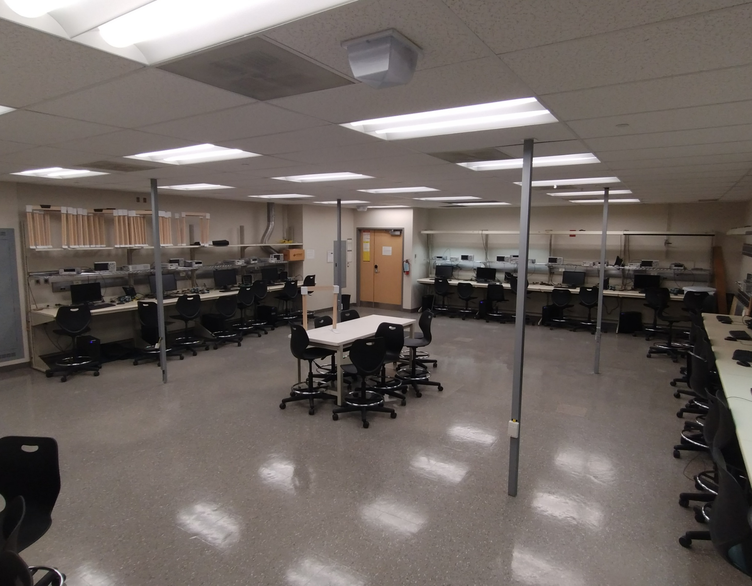
SCHEDULE / LOCATIONS FOR WEEKS 4, 5, 6
Week 4 (Sept 24): CAD model review
Week 5 (Oct 1): Prototype review
Week 6 (Oct 8): System Demonstration
Meet each week in E3-3178 during Workshop time (9:30 AM to 11:30 AM)
4 minutes to present

Slide 22
WHAT TO DO WHILE WAITING FOR REVIEW
Complete Mandatory Safety Training
LEARN Course SO2500 “Risk Assessment”
Any training required for WATIMAKE (laser cutting, 3D printing)
Manufacture prototype parts (base, beam, motor mount)

